Slide 1
Microwave detection and imaging of Alzheimer's-related brain changes
DUAL DEGREE PROJECT · PROGRESS REVIEW
From a single-layer sectored sphere to a layered, lobe-sectored head: what a six-antenna ring can classify, and what it can image
Jatin · supervisor Prof. Anirban Sarkar · IIT Bombay
Notes:
Opening: last time we showed the single-layer sectored sphere. Today: why we moved to a layered head, how we classify stages, why we changed the feature, the lobe-sectored phantom the professor asked for (layers + sectors), and imaging results with their controls. Everything is HFSS simulation of one idealised head; I will say clearly what is robust and what is not.

Slide 2
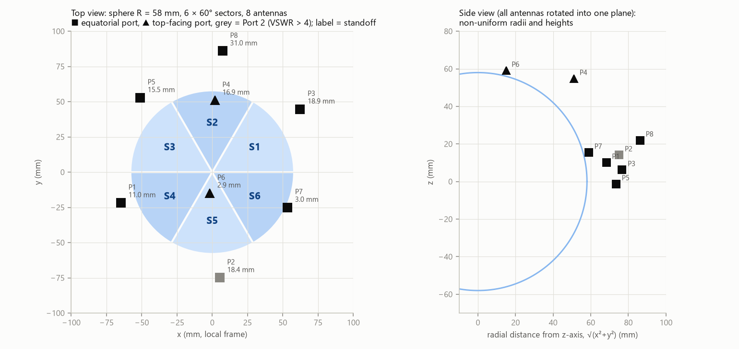
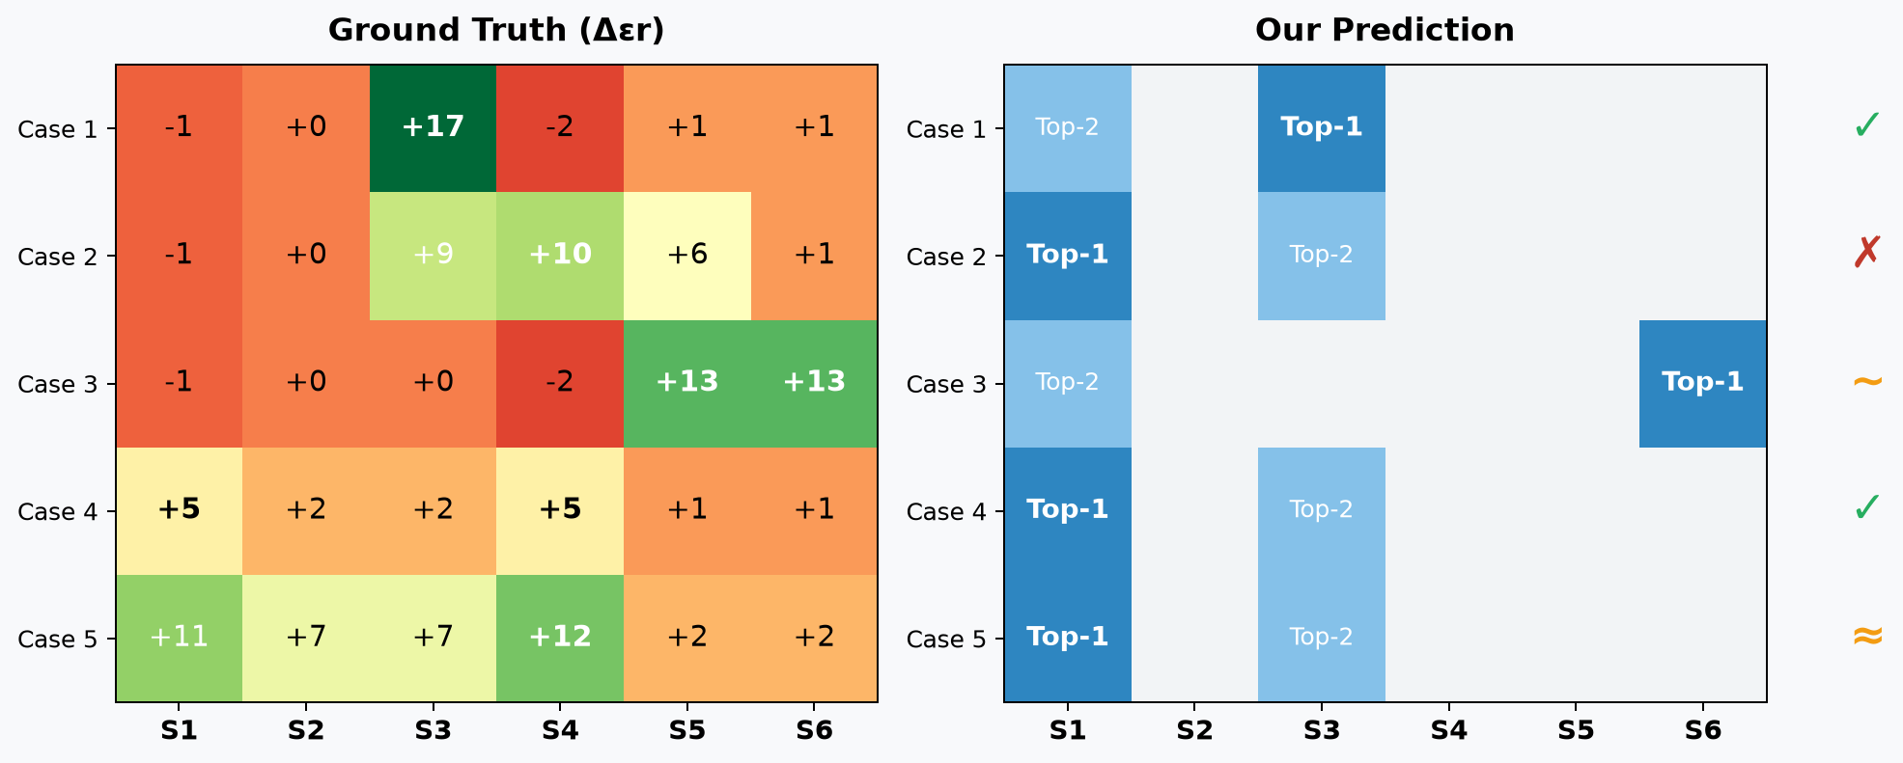
Single-layer sectored sphere: the change was easy to detect, its location was not
WHERE WE LEFT OFF
Set-up
Result
Why, and the lesson
58 mm sphere, six 60° sectors, 8 antennas. Healthy baseline plus 5 cases raising εr of one or more sectors by 5–17.
Every case detected. Top sector right in at most 3 of 5 cases; with realistic noise, chance level.
Hits followed the hardware: uneven stand-offs (2.9–31 mm), one port ~10× stronger, one mismatched. → symmetric ring, equal stand-off, gain-free features.
Notes:
The single-layer phase taught us the design rules. Detection worked for every perturbation case, but localisation followed antenna biases: Port 5 had about 10x gain (pulls calls to S3), one antenna pair P3-P8 dominated (S1), Port 2 was badly matched (VSWR > 4, S5), stand-offs ranged 2.9-31 mm, and the analysis band 3.3-3.5 GHz missed the resonances near 3.66 GHz. These were perturbation cases, not AD stages. Lesson: a symmetric ring with equal stand-off, and features that cancel each antenna's gain.

Slide 3
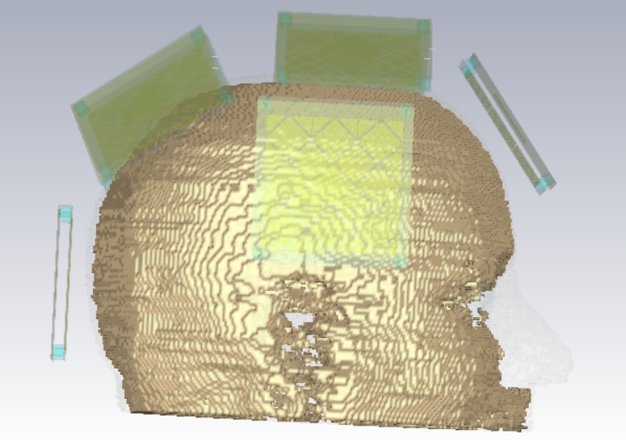
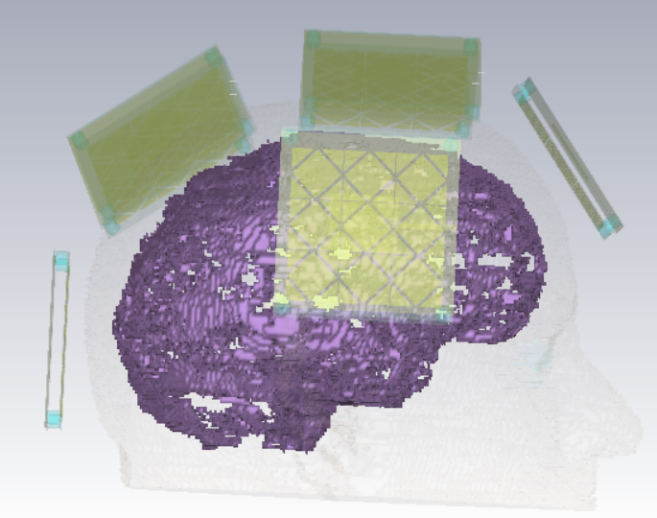
CSF wraps the whole brain, directly under the skull
WHY LAYERS, WHY CSF
CST voxel head: CSF (purple) is one continuous layer over the brain surface, so it is the first brain-side tissue every antenna sees.
In AD the cortex shrinks and CSF fills the space; gray matter, white matter and CSF also change εr and σ. → model the head as layers, CSF as its own layer.
Notes:
Defence if asked "earlier CSF was uniform, now regional?": the voxel image shows CSF is PRESENT everywhere, which is why it is a layer. How much it EXPANDS differs by lobe (Shehab 2025 Table 7); the uniform model is the global average, the lobe model the refinement. Purple = CSF compartment as exported from CST.

Slide 4
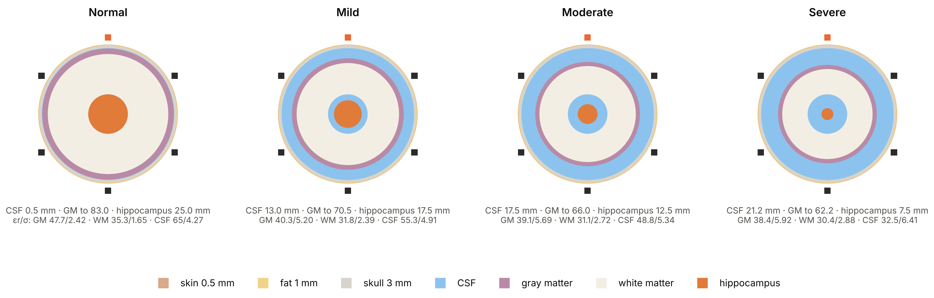
Seven concentric layers: with each stage, gray and white matter shrink and CSF expands
MODEL 1 · LAYERED SPHERICAL HEAD
Radii and εr / σ per stage from Shehab et al. 2025 (Tables 5–6, values at 3.24 GHz, held constant over the band). The CSF outer boundary stays at 83.5 mm, so CSF grows from 0.5 mm (Normal) to 21 mm (Severe). Every change is radially uniform.
Notes:
Layers outer to inner: skin 88, fat 87.5, skull 86.5, CSF 83.5, gray 83, white 76, hippocampus 25 mm (healthy). Stage radii: gray 83 / 70.55 / 66.05 / 62.25, white 76 / 64.6 / 60.8 / 57, hippocampus 25 / 17.5 / 12.5 / 7.5 mm. MCI changes only the hippocampus (21.25 mm). If asked "can you predict radius changes?": in this uniform model we only classified; in the lobe model the imaging estimates the cortex retreat per lobe (next section).

Slide 5
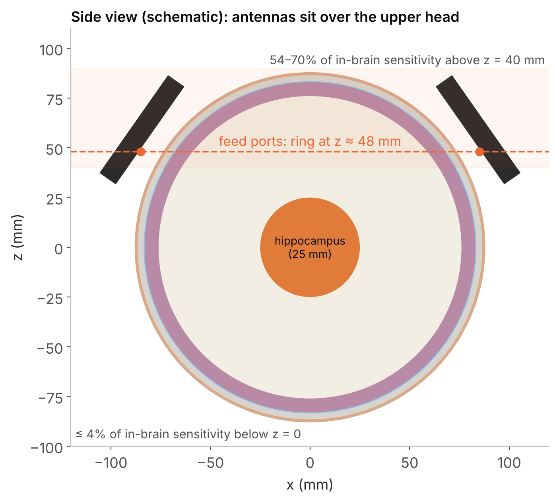
Six DGS-patch antennas with AMC reflectors, evenly spaced over the upper head
ANTENNAS AND RING
Antenna: DGS patch, 42 × 35 mm, on Rogers RT/duroid 6010 (εr ≈ 10.2, 1.575 mm), 3 × 3 FR4 AMC behind; resonance on the head ≈ 3.6–3.7 GHz.
Ring: feeds 97.6 mm from the centre at polar angle 60.5° (z ≈ 48 mm), 60° apart, ≈ 9 mm from the skin. T1 at the nose; +x is the subject's left.
Paths: 6 reflections and three transmission classes: neighbour (60°), second-neighbour (120°), opposite (180°).
Where the signal goes: the opposite path travels around the surface (group delay 3.61 ns vs 3.69 ns surface path, 6.03 ns straight through). ≈ 99% of path sensitivity is in air; inside the brain it decays over ≈ 1 cm.
Notes:
Port order in the Touchstone files: Port 1..6 = T4, T3, T2, T1, T6, T5, confirmed from the HFSS geometry (port-sheet azimuths) and the field exports. In-brain sensitivity: 54-70% above z = 40 mm, at most 4% below z = 0, which is why the hippocampus (MCI) and low temporal regions are out of reach.

Slide 6
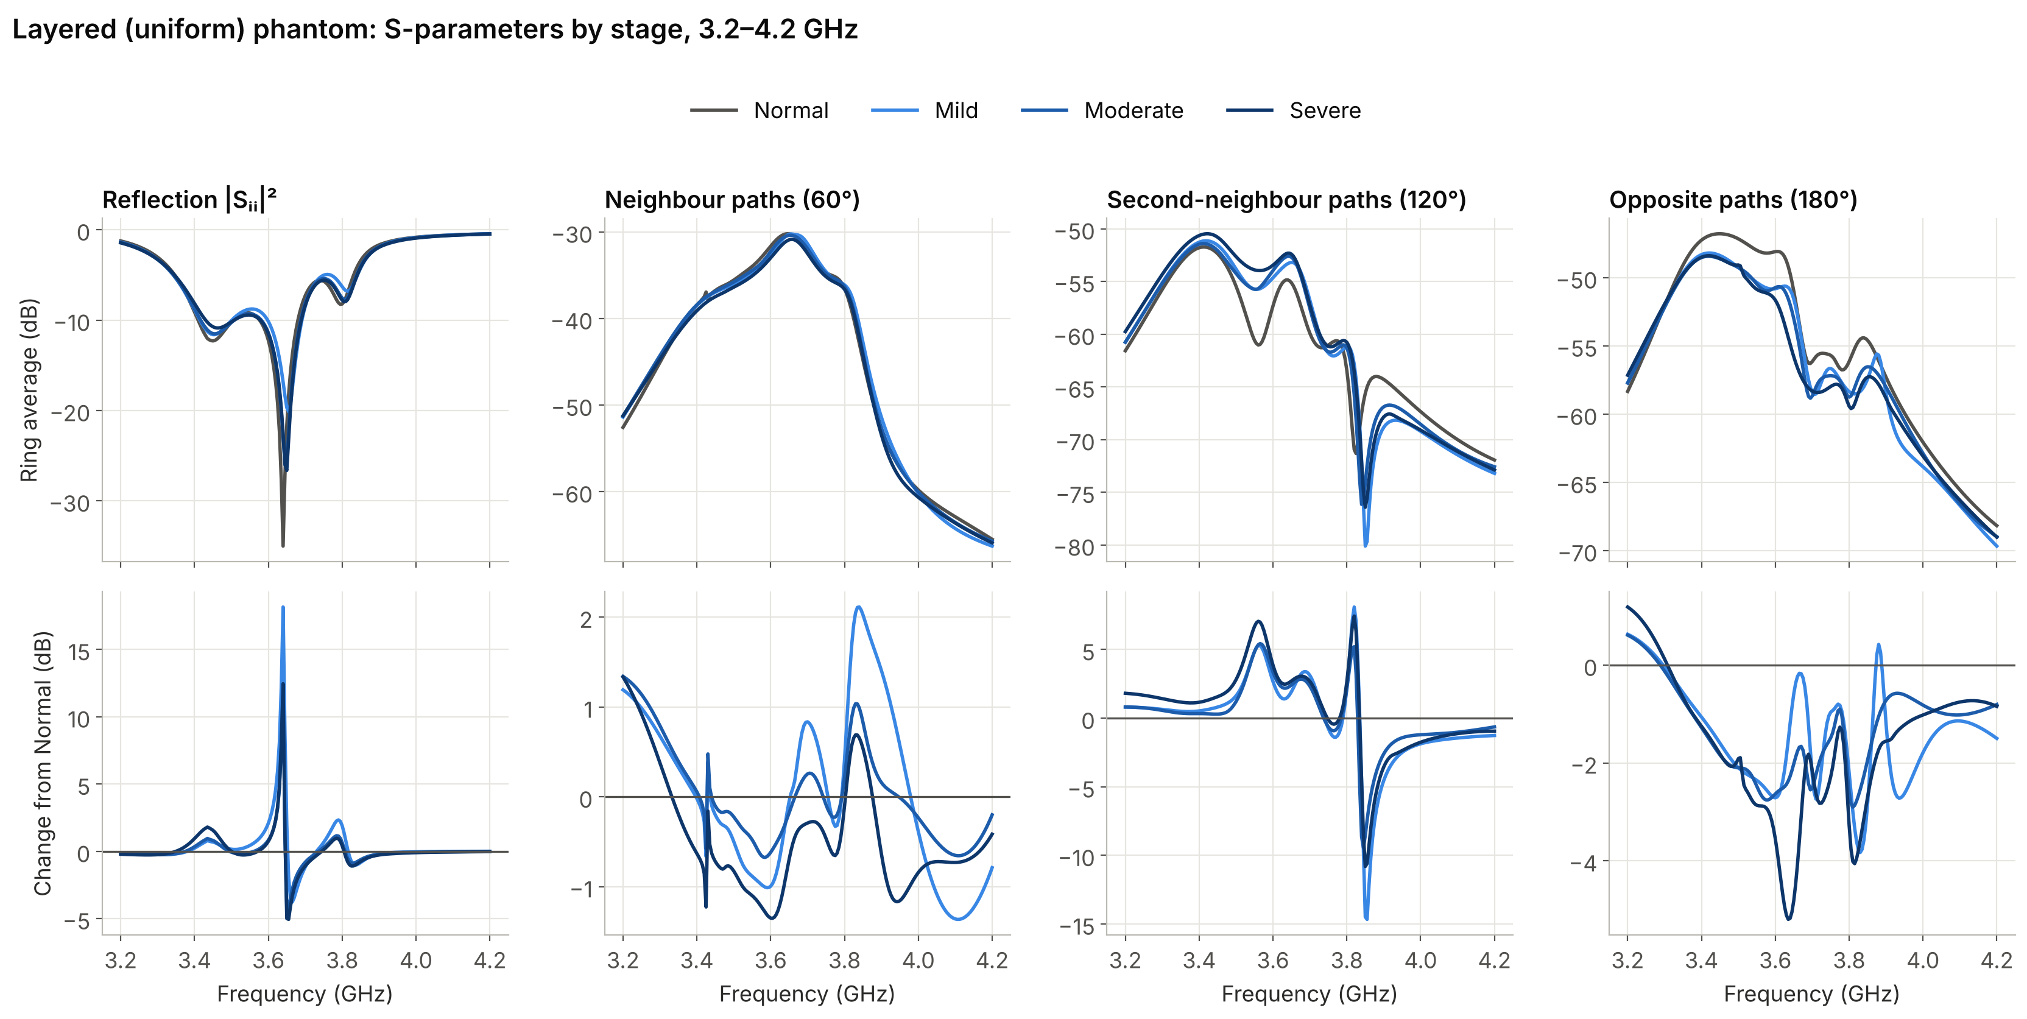
With uniform atrophy the opposite paths drop, while the neighbour paths barely move
MODEL 1 · S-PARAMETERS
Band-mean change from Normal (3.2–4.2 GHz): opposite paths −1.4 / −1.3 / −1.6 dB for Mild / Moderate / Severe; neighbour paths +0.04 / +0.04 / −0.44 dB. Reflection changes sit in sharp swings around the 3.65 GHz notch.
Notes:
Read top row = ring average of each path class; bottom row = stage minus Normal. The opposite path is the consistent detection signal. The reflection changes are large but only in a narrow band around the notch, which is exactly the region where small shifts of the resonance dominate; we do not build features on the notch.

Slide 7
10·log(1 − |Sᵢᵢ|² − Σ|Sᵢⱼ|²) is, in practice, the reflection alone
WHY NOT ABSORBED POWER?
Uniform head, band average per antenna | Normal | Severe | Change
|Sᵢᵢ|², reflected | 0.437 | 0.425 | −0.012
Σ|Sᵢⱼ|², sent to the other 5 ports | 4.1 × 10⁻⁴ | 3.5 × 10⁻⁴ | −6 × 10⁻⁵
1 − |Sᵢᵢ|² − Σ|Sᵢⱼ|² (dB) | −2.499 | −2.407 | +0.09
1 − |Sᵢᵢ|² alone (dB) | −2.496 | −2.404 | +0.09
The transmissions are ≈ 0.1% of the quantity, so it tracks each antenna's own matching.
A realistic ±0.5 dB on Sᵢᵢ moves |Sᵢᵢ|² by ±0.05: about 900× the entire transmission change.
It also counts power radiated into air, so it is not tissue absorption. Measured: it does not separate Normal from AD.
Notes:
The idea of using every path is right; summing them in linear power is what buries the transmissions under the reflection. Ratios of path classes keep them. Numbers: v2 uniform solves (one HFSS project), band 3.2-4.2 GHz. Separation of this quantity: Fisher 0.15 (95% 0.004-0.52) against 28 for R31, next slide.

Slide 8
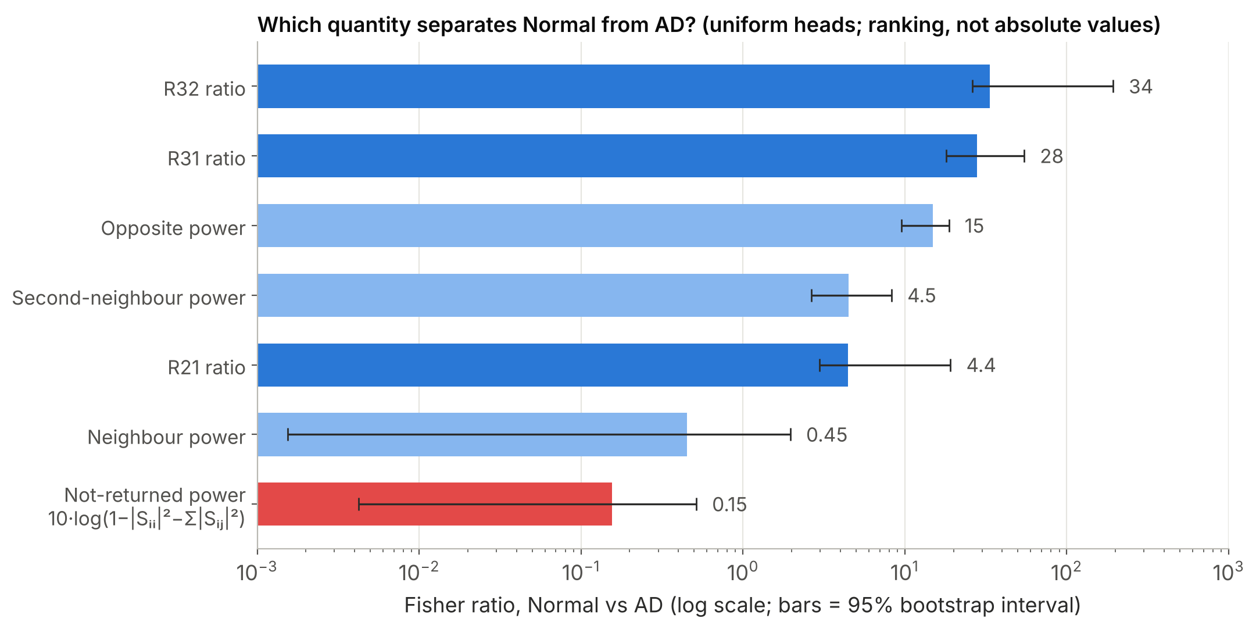
Ratios of path classes separate Normal from AD; single powers do not
CHOOSING THE FEATURE
R31 and R32 lead; not-returned power is last.
Bhattacharyya distance and symmetric KL give the same order (R31: 7.0 / 72; not-returned power: 0.04 / 0.31).
Absolute values depend on the covariance model: read the ranking.
Notes:
Fisher ratio = (difference of class means)^2 / (sum of class variances); Bhattacharyya distance and symmetric Kullback-Leibler divergence computed with Gaussian class models. Intervals are 95% bootstrap over solves. The covariance comes from very few solves, so the absolute numbers move with how it is regularised (a factor 6-74 between x0.1 and x10 scaling); the ranking is stable.

Slide 9
Ratios of ring-averaged path powers: free of antenna gain by construction
THE FEATURE
Definition
Gain cancels exactly
A port gain gᵢ scales Sᵢⱼ by gᵢgⱼ. Each antenna appears twice in C₃ and twice in C₁, so ∏|gᵢ| cancels in every ratio.
Cₖ = geometric mean over the six antennas t of the band-averaged |S(t+k, t)|², k = 1, 2, 3, over 3.2–4.2 GHz (201 points)
R31 = 10·log₁₀(C₃ / C₁) — detection
Not a notch tracker
R21 = 10·log₁₀(C₂ / C₁) — staging
No resonance frequency or depth is used; reflections are not used at all. The whole band is integrated.
R32 = R31 − R21
Honest caveat
The separation comes from 3.2–3.8 GHz, around and below the resonance; 3.8–4.2 GHz alone does not separate.
Notes:
Gain proof: |S_ij|^2 -> |g_i|^2 |g_j|^2 |S_ij|^2. Over t = 1..6, the terms S(t+3,t) contain each port twice, and so do the terms S(t+1,t). The geometric mean of each set therefore scales by (prod |g_i|^4)^(1/6); the ratio is unchanged. If asked "you are just tracking the dip": the feature never picks a notch frequency or depth and does not use S_ii; but the disease information lives in the band near the antenna's operating frequency, which we report as a band dependence.

Slide 10
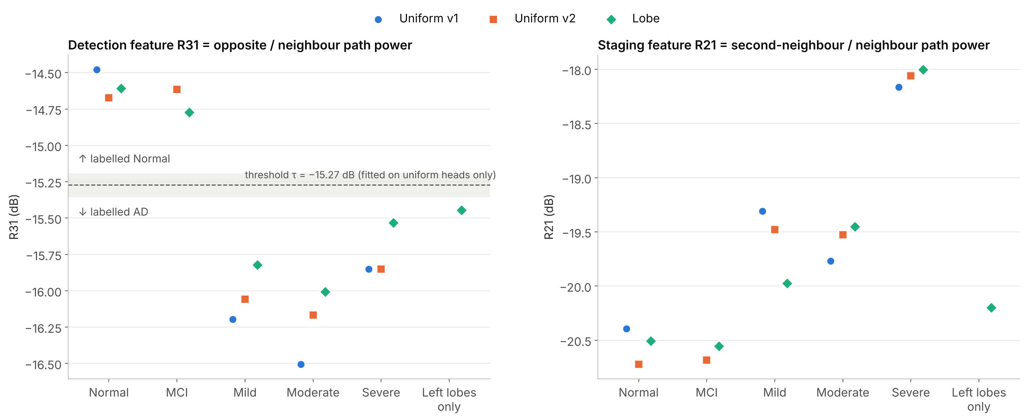
One threshold, fitted on uniform heads, sorts every design, including unseen lobe heads
CLASSIFICATION
R31: all Normal and MCI designs above τ, all AD designs below. R21 rises with stage; Mild and Moderate overlap on the uniform heads.
Notes:
The threshold tau = -15.27 dB and the staging boundaries were fitted on the uniform heads before any lobe design existed; the lobe designs are a test the rule never saw. R31 is not monotonic: at Severe the neighbour coupling also falls (-0.44 dB), so R31 moves back toward Normal. R31 is a detection feature, R21 the staging feature.

Slide 11
What is clear and what is borderline
CLASSIFICATION SUMMARY
Design | Truth | Label | Margin (dB) | Verdict
Uniform heads (training, 9 solves) | all stages | all correct | 0.50–1.15 | clear
Lobe head, healthy | Normal | Normal | 0.45 | clear
Lobe head, MCI (hippocampus only) | MCI | Normal | 0.42 | as expected
Lobe head, Mild | AD | AD | 0.47 | clear
Lobe head, Moderate | AD | AD | 0.66 | clear
Lobe head, Severe | AD | AD | 0.18 | borderline
Lobe head, left lobes only | AD | AD | 0.09 | borderline
Staging labels (Normal / Mild–Moderate / Severe) come out right for the lobe designs, but with small margins; Mild vs Moderate is not separable on any feature. Margin = distance of R31 from the uncertain band τ ± 0.08 dB.
One simulated head per stage: these show robustness to noise and calibration error, not yet generalisation across people.
Notes:
Robustness: the labels stay the same under +-0.5 dB and +-2 dB / +-10 degree per-antenna gain and phase errors, and at twice the chosen noise (left-only drops to 94%). Severe and left-only sit close to the band because R31 turns back at Severe and because one-sided disease changes the ring average less. MCI is labelled Normal, which is physically expected: the hippocampus is far below the sensing depth. Why staging margins are small: R21 rests on the second-neighbour paths (about -55 dB). Two equivalent simulations of the same healthy lobe head differed by up to 0.36 dB in R21, about a third of the Normal-to-Mild step, while R31 moved only 0.10 dB, inside its margin. Detection holds; staging is indicative.

Slide 12
A spherically symmetric head cannot say where
WHY A SECOND MODEL
Every antenna sees the same uniform head, so location information is absent by construction.
AD atrophy is regional and follows a known lobe order (Saied et al. 2022, Table II); CSF expansion per lobe and stage is tabulated (Shehab et al. 2025, Table 7).
So: keep every layer, cut gray and white matter into six lobe sectors, one under each antenna, and apply each stage only where the papers place it.
Notes:
This is the hybrid the professor asked for: radial layers plus lateral sectors in one geometry.

Slide 13
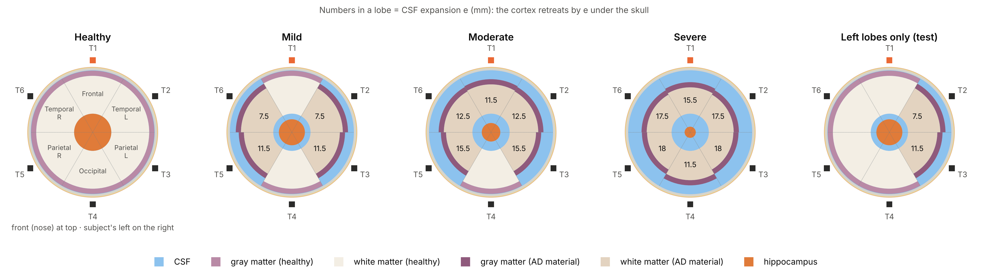
Six 60° lobe sectors inside the layered head, diseased where the papers put AD
MODEL 2 · LOBE-SECTOR PHANTOM
In lobe k the cortex retreats by eₖ: gray from 76 − eₖ to 83 − eₖ mm, white from 25 to 76 − eₖ. CSF fills every gap as one compartment, with the stage's material.
Mild: temporal and parietal lobes. Moderate: frontal added. Severe: all six. Left lobes only: a test design with disease on one side.
Notes:
Built in HFSS by script from the healthy layered design: same antennas, same ring, same solver settings. Stage table e_k (mm), lobes Frontal / Temporal L / Parietal L / Occipital / Parietal R / Temporal R: Mild 0 / 7.5 / 11.5 / 0 / 11.5 / 7.5, hippocampus 17.5; Moderate 11.5 / 12.5 / 15.5 / 0 / 15.5 / 12.5, hippocampus 12.5; Severe 15.5 / 17.5 / 18 / 11.5 / 18 / 17.5, hippocampus 7.5. CSF defence: CSF thickness changes per lobe, its material changes everywhere because it is one connected compartment, as in reality. Lobes are azimuthal wedges of the upper head: a schematic placement, and aligned with the antennas, which is favourable.

Slide 14
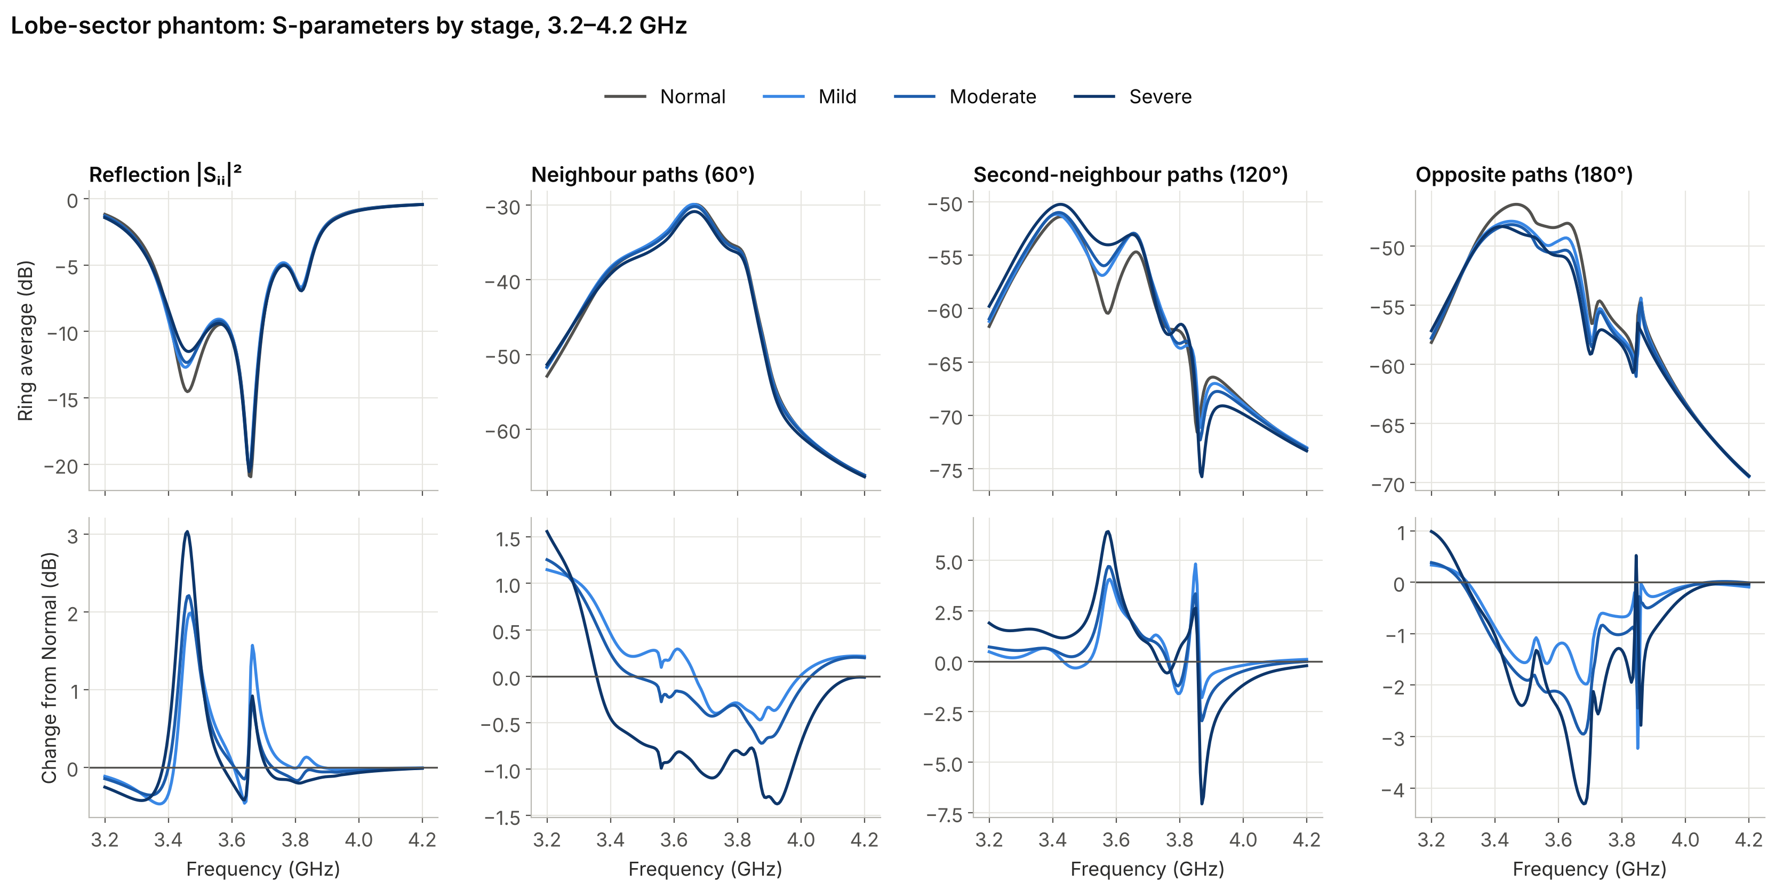
Regional disease gives smaller changes, still carried by the long paths
MODEL 2 · S-PARAMETERS
Band-mean change from Normal: opposite paths −0.60 / −0.87 / −1.11 dB, second-neighbour +0.47 / +0.49 / +0.65 dB. The 3.66 GHz reflection notch does not move with disease here: the information is in the transmissions.
Notes:
Compare with the uniform head: the same direction of change, about half the size, because only some lobes change. This is why the frozen threshold still works for Mild and Moderate lobe heads but sits close for left-only.

Slide 15
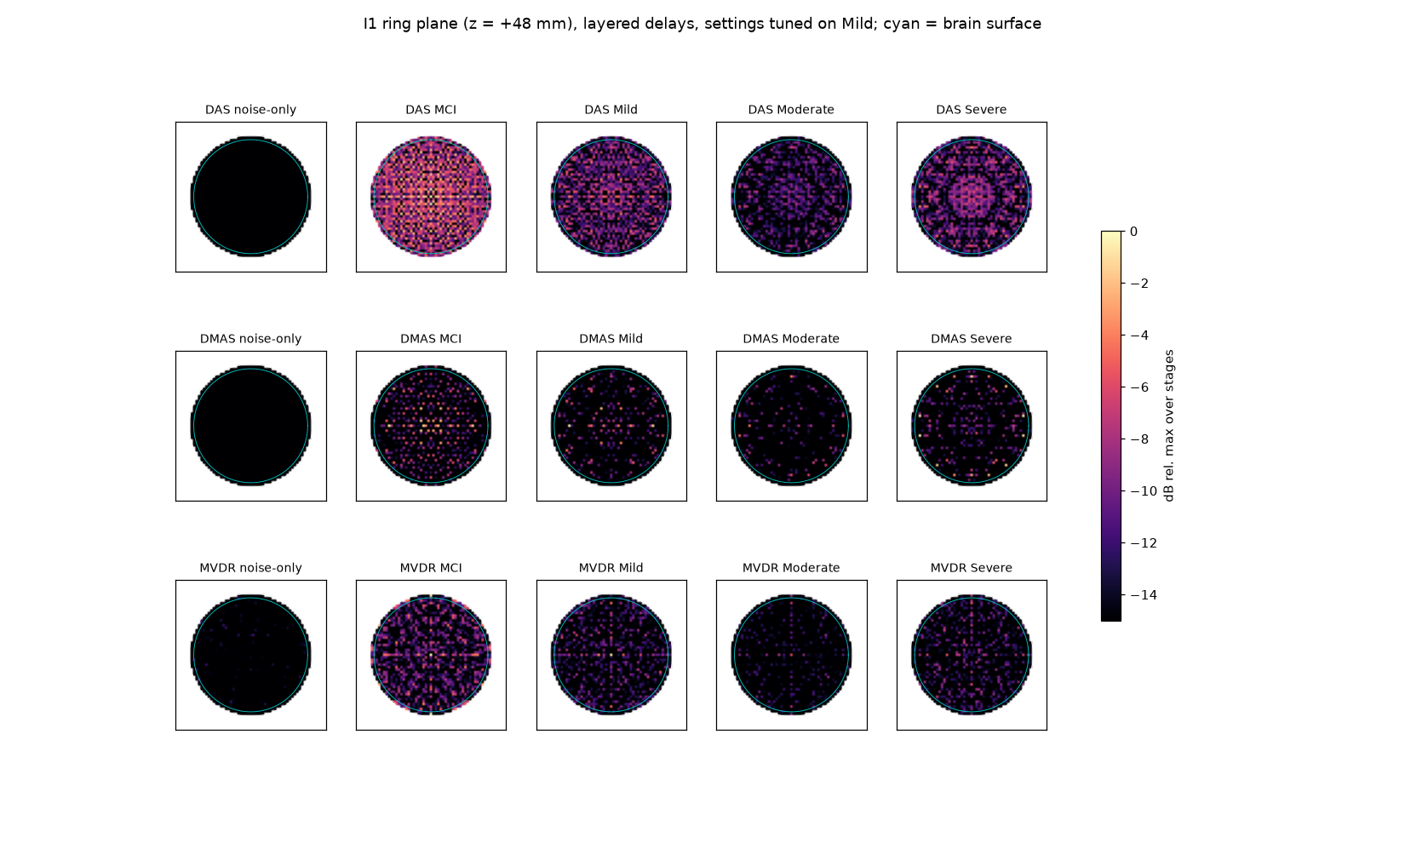
Radar beamforming and a linear inversion could not image this head
IMAGING · WHAT DID NOT WORK
DAS / DMAS / MVDR: speckle, no anatomy. MCI, which nothing else can see, gives the brightest DAS image: an artefact.
Why: a 1 GHz band in tissue resolves c / (2B√εr) ≈ 22 mm, from only 21 independent paths.
Linear (Born) sector inversion: model error 56–67% of the measured change, as large as the signal; sector calls flipped with the regularisation weight in 16 of 20 cases.
Power-only left/right indices: no left–right difference in the left-only head.
Notes:
Range resolution: c / (2 B sqrt(er)) = 3e8 / (2 x 1e9 x 6.9) = 22 mm for er about 47.7. The linear model uses healthy-head fields for changes of 7-18 mm, which is far outside its validity. These failures pointed to a parametric approach with a strong anatomical prior.

Slide 16
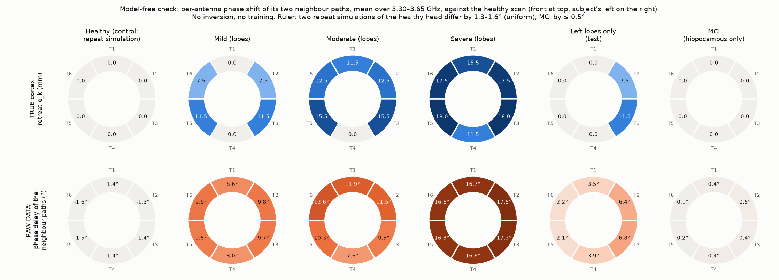
The lobe pattern is visible in the raw phase, before any model
MODEL-FREE CHECK
Phase delay of each antenna's two neighbour paths vs the healthy scan, 3.30–3.65 GHz. Left lobes only: 6.4–6.8° at the left antennas vs 2.1–2.2° at the right. Moderate: frontal 11.9° vs occipital 7.6°. MCI ≤ 0.5°.
Notes:
No inversion, no training: this is the measured data. The information about where the disease is lives mostly in phase, which power-based features throw away. Caveat to say: the 3.30-3.65 GHz window was chosen after earlier analysis of the left-only design. Most of the shift is common to all antennas (CSF material changes everywhere); the lobe pattern is a 1-4 degree modulation on top.

Slide 17

Image = known healthy anatomy + a change estimated from the S-parameters
IMAGING · METHOD
1 · Baseline
2 · Forward model
3 · Inversion
4 · Render
Healthy layered head: geometry, εr and σ of every layer. Like a patient's earlier scan.
Predicts amplitude and phase of all 21 paths at 201 frequencies. Physics input: the layered-tissue reflection change ΔΓₖ(f) of each lobe. Shared across the ring's 12 symmetries; trained without the design being imaged.
Unknowns: the stage (material table) and, per lobe, the cortex retreat eₖ. Bayesian sampling gives a posterior with uncertainty and a fit value χ²/dof.
Move the boundaries by êₖ, fill with CSF, swap materials; slice. Fade where the HFSS fields show no sensitivity.
The data decide which lobes changed, how far, and the stage; the anatomy prior decides the shape (60° wedges).
Notes:
Details: surrogate = ridge regression on the complex log-ratio ln(S / S_healthy); 12 symmetries = 6 rotations x mirror of the ring, so each solved design gives up to 12 training examples. Leave-one-design-out: the design being imaged and its repeat solve are never in training. Gibbs sampling over lobe states, stage evidence by Chib's method. Disclosed: the layered-tissue features and the widening of uncertainty when the fit is poor were adopted after seeing held-out results; both are applied by one rule to every design.

Slide 18
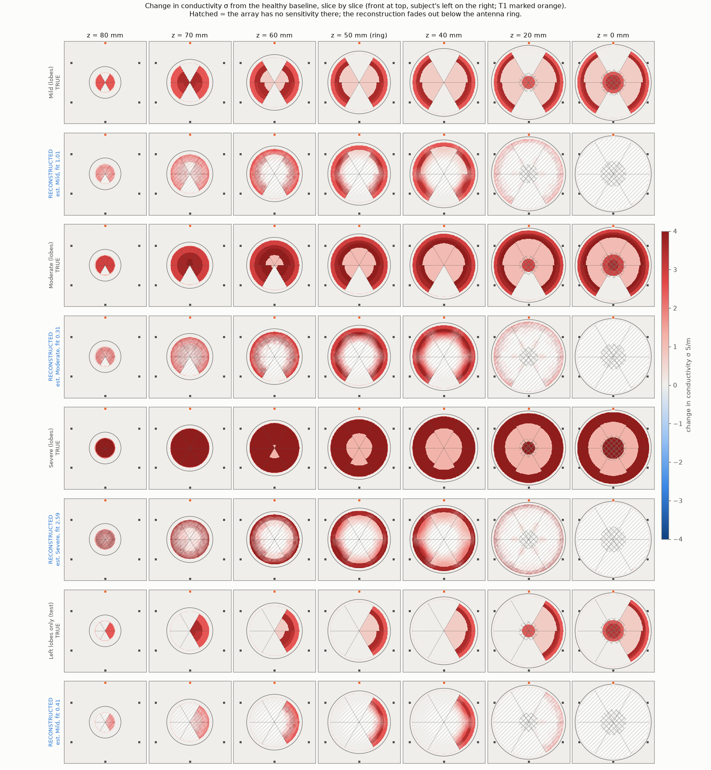
Conductivity change, slice by slice
IMAGING · RESULTS
Rows: truth, then reconstruction, for Mild, Moderate, Severe and left lobes only. Columns: heights z = 80 to 0 mm; front at top, subject's left on the right.
Which lobes changed: correct for Mild, Moderate and left lobes only.
Height is not measured: one antenna ring fixes which lobes changed and by how much; the vertical shape comes from the lobe model.
Below z ≈ 30 mm: no sensitivity, so hatched.
Severe: stage and lobes right, depth wrong; its fit value (2.59) flags it.
Notes:
How to read depth: z is height; depth is measured inward from the brain surface. At z = 50 mm the brain cross-section has radius ~66 mm and the sensed shell (~15 mm deep) shows as an annulus ~20 mm wide; the centre is hatched. Every slice is drawn from the same seven estimated numbers (the stage and one retreat per lobe), because the lobes are modelled as full-height wedges: the change across z is geometry (the brain cross-section shrinks) and the sensitivity fade, not a measured vertical profile. With all antennas at z of about 48 mm the paths cannot tell height apart; 54-70% of the in-brain sensitivity is above z = 40 mm and at most 4% below z = 0. Show z = 50-70 as the sensed images. Measuring height would need a second antenna ring at another height.

Slide 19
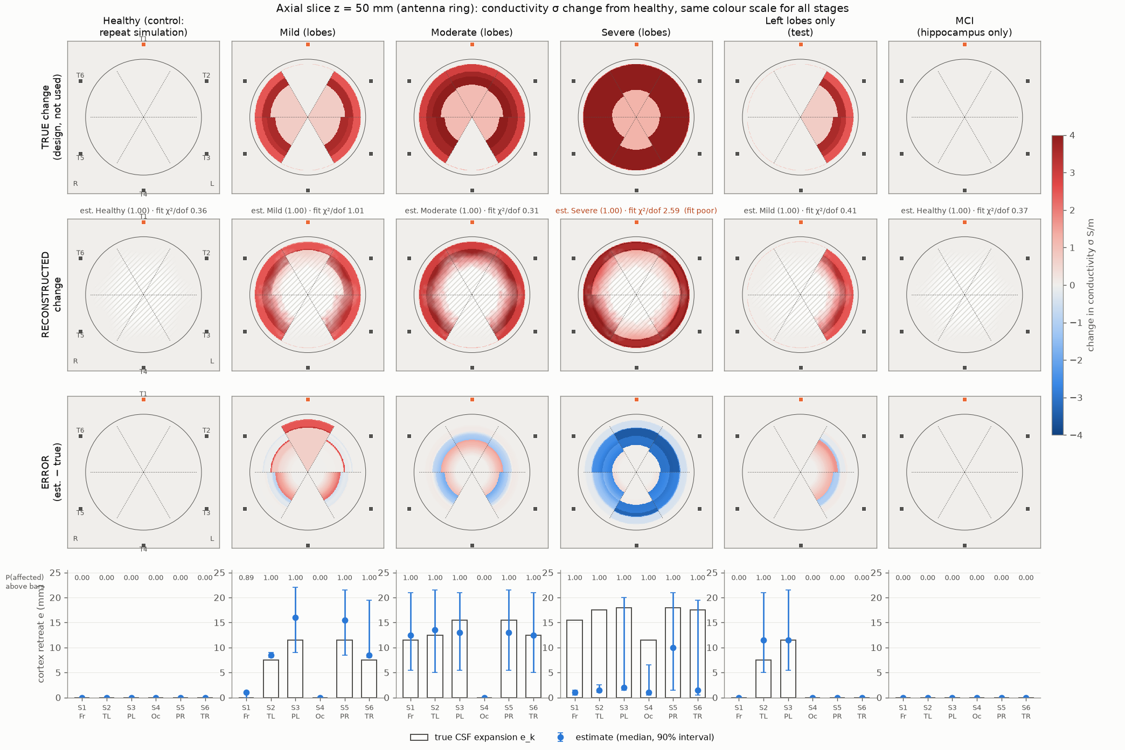
Truth, reconstruction and error at z = 50 mm, with per-lobe estimates
IMAGING · SCORES AT THE ANTENNA RING
Mild: 5–6 of 6 lobes right; retreat error 2.6–3.0 mm.
Moderate: 6 of 6; error 1.4–3.0 mm; occipital correctly spared.
Left lobes only: 6 of 6; error 2.0 mm; left minus right +11.5 mm (truth +9.5).
Severe: 6 of 6 lobes, but retreat 12–13.5 mm too shallow.
Healthy, MCI: empty change map.
Notes:
Scores are leave-one-design-out: nothing from the imaged design enters the model; the truth is used only for this scoring. Correlation of the reconstructed conductivity map with the truth over the sensed brain: Mild 0.82-0.94, Moderate 0.91-0.94, left-only 0.97, Severe 0.09-0.17. Severe fails on depth because Severe CSF (sigma 6.4 S/m) attenuates the field within about 5 mm; the fit is equally good for any retreat between 6 and 20 mm.

Slide 20
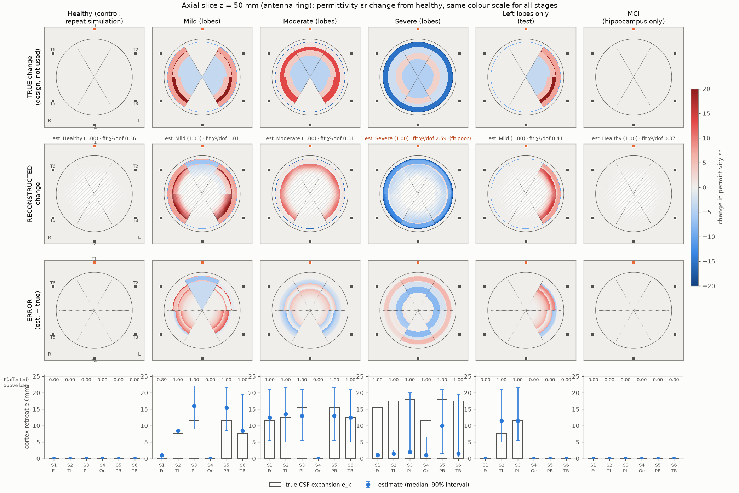
The same estimate, shown as the change in permittivity
IMAGING · PERMITTIVITY VIEW
εr and σ maps come from one estimate (which lobes, how far, which stage), rendered with each stage's tissue values.
Red: CSF (εr 55–65) replacing gray matter (εr 40–48) in Mild and Moderate.
Blue in Severe: its CSF has εr 32.5, lower than the healthy tissue it replaces.
Notes:
Conductivity shows the change more strongly in relative terms (diseased CSF sigma about 2x gray matter), which is why the conductivity view is used as the main slide; the permittivity view carries the same information.

Slide 21
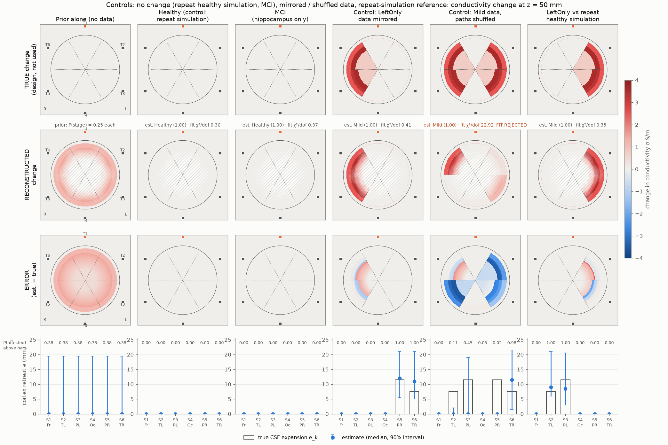
The images follow the data, not the drawing
IMAGING · CONTROLS
No data: a faint uniform ring (P = 0.38 everywhere), not a lobe pattern.
Healthy, MCI: empty.
Healthy head re-simulated at two other orientations: empty in 8 of 8 runs.
Left-only data mirrored: exactly the right lobes.
Paths shuffled: a lobe-like image, but the fit rejects it (χ²/dof 22.9 vs 0.3–1.0 for real data). Every panel prints its fit value.
Notes:
The shuffled-data control is the important warning: the method can paint lobes from garbage, and only the fit test catches it. That is why the fit value is printed on every reconstruction and why a rejection threshold is fixed before the blind test.

Slide 22
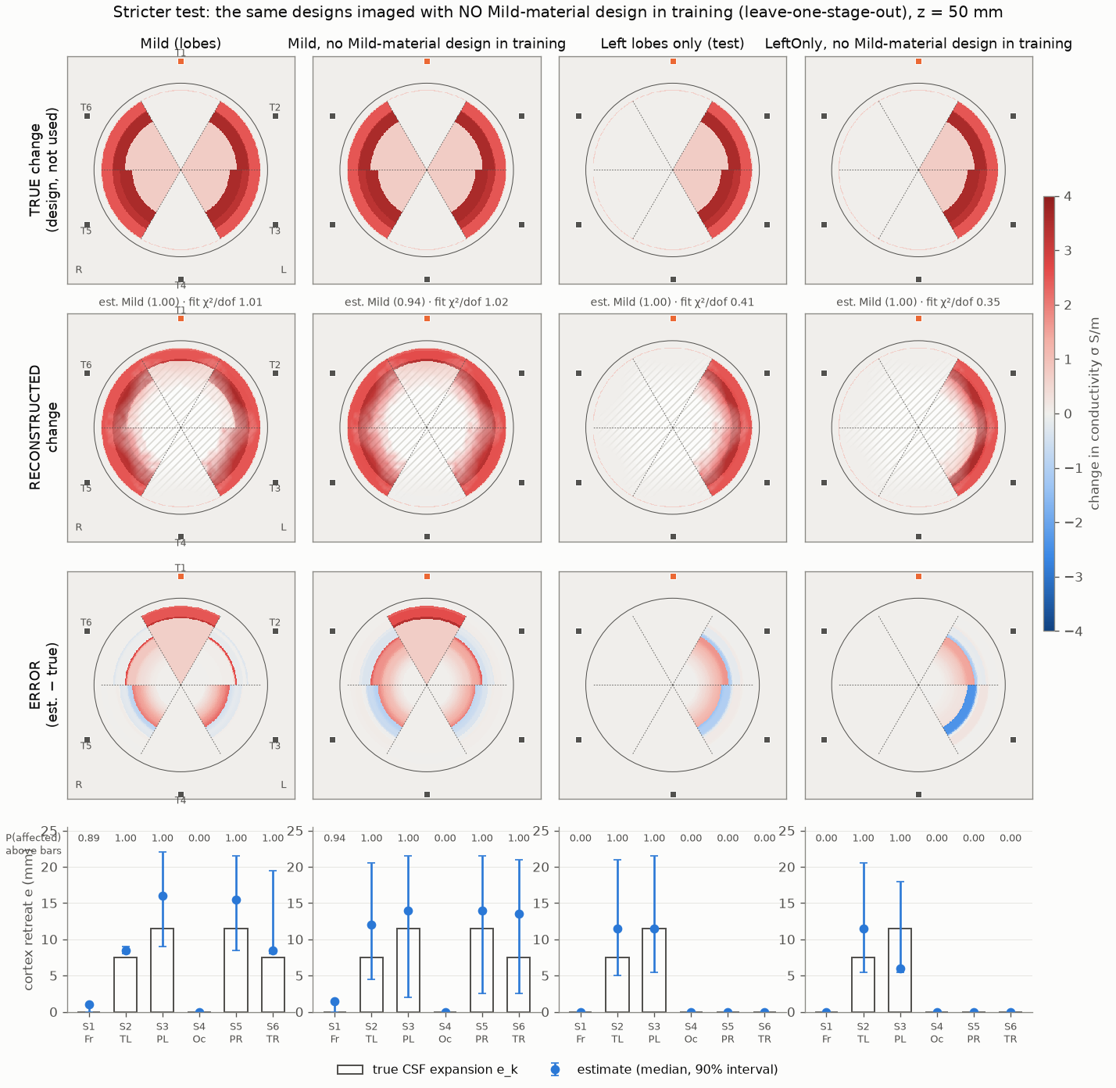
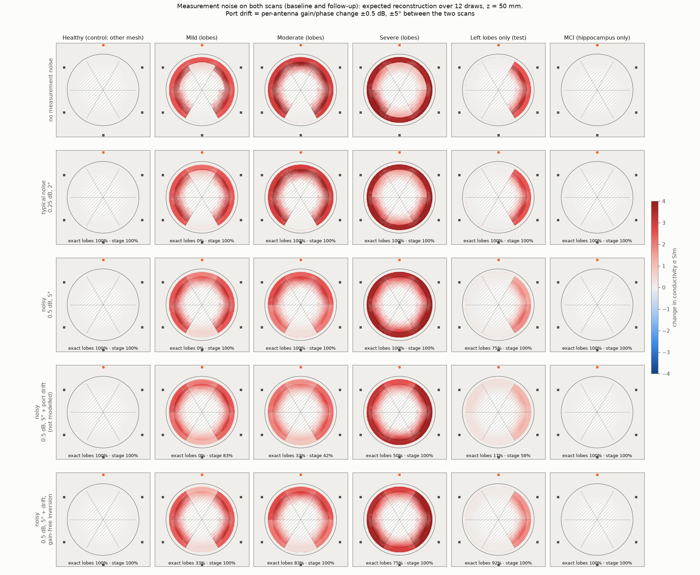
Not a look-up of a similar design, and stable under measurement noise
IMAGING · ROBUSTNESS
No Mild-material design in training: left-only still exactly the two left lobes.
±0.5 dB / ±5° on both scans: left side in 100% of draws, exact lobes 75%, never right.
Antenna drift between scans: 17% exact unless gains are removed (92%).
Notes:
Noise also biases the retreat estimate low. For any real measurement the gain-removing inversion should be the default, because per-antenna drift between a baseline scan and a follow-up scan is unavoidable.

Slide 23
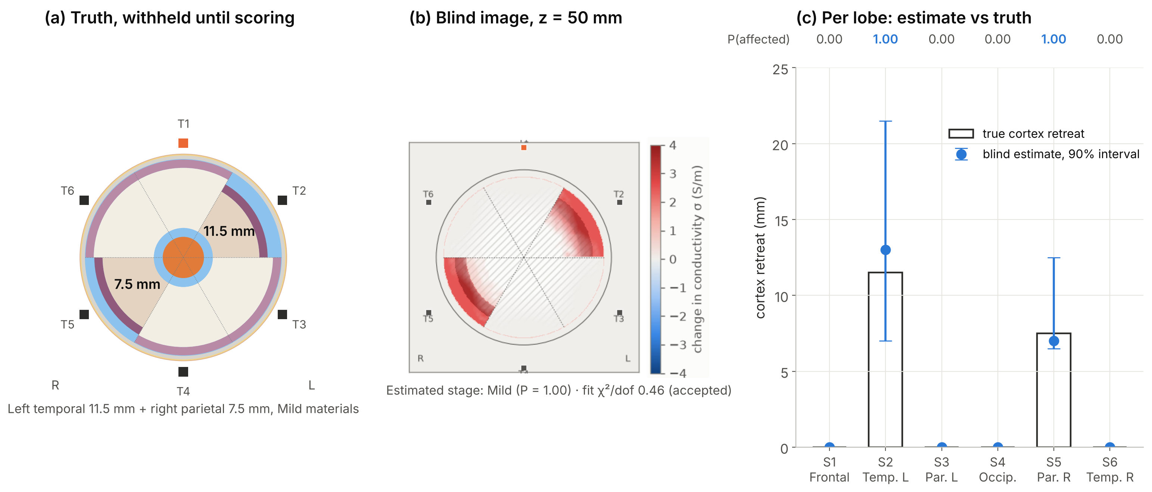
A pattern never simulated before: the image found both lobes and the stage
BLIND TEST · SCORED
Lobes: the two true lobes and nothing else; guessing this pair has a 1-in-63 chance.
Stage: Mild, correct. Depth: 13.0 vs 11.5 mm and 7.0 vs 7.5 mm.
Caveat: one design; stage and depth vary with the healthy baseline used, the lobes do not.
Notes:
Protocol and fit-rejection threshold were committed before the file existed; the geometry was stripped from the file header and held back until all three analyses had committed their estimates. The design (left temporal 11.5 mm + right parietal 7.5 mm, Mild materials) is not a rotation or mirror of any solved design, and both sides are affected, so it cannot be read off the left-only result. A separate pattern fit of the raw phase, with no imaging model, also picked exactly this pair as its best pattern. Raw data: the per-antenna phase delay is largest at T2 and T5, the antennas over these lobes, but that elevation (about 1.6-2 degrees) is only 1.5-2x the spread between two healthy simulations, so it supports the image rather than proving it on its own. Against other simulations of the healthy head as baseline, the lobe calls held in 6 of 6 runs; one baseline staged it Moderate instead of Mild. The mirrored left-only design, solved separately, was also imaged with exactly its two right lobes. Honest caveats: this is one design; depth is the weak part - two alternative reference settings of the same blind run gave 3.5-6.5 mm for the temporal lobe, and in the mirrored design depth came out 3-3.5 mm against 7.5-11.5. The simple ratio rule (previous section) labelled this design Normal, as it did the left-only design: partial disease is below its staging threshold.

Slide 24
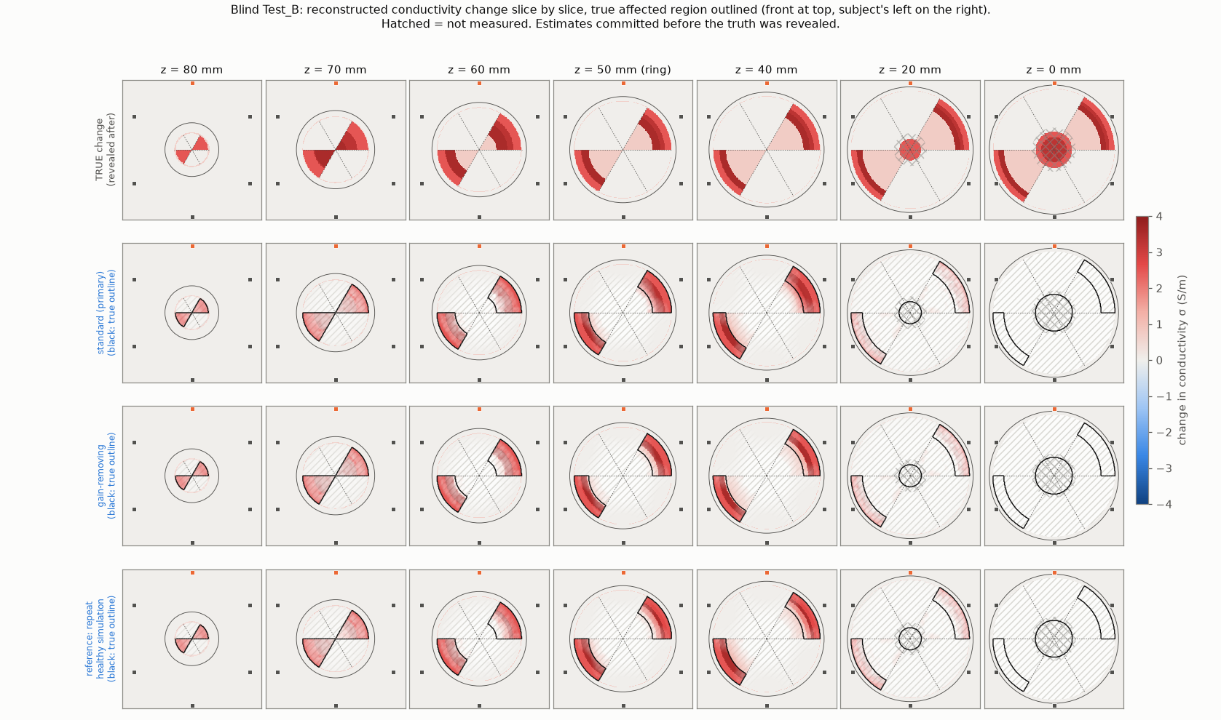
The blind result drawn through the head: the change sits inside the true lobes
BLIND TEST · SLICE BY SLICE
Rows: truth, then three blind reconstructions. Black outline = true lobes, drawn after scoring.
How to read it: the data fix which lobes and how much; the vertical shape comes from the lobe model.
Below z ≈ 30 mm: no sensitivity (hatched); the hippocampus is out of reach.
Notes:
Estimates were committed before the truth was revealed; the truth row and outlines were added afterwards. Second row: standard inversion (the scored one). Third: gain-removing inversion, the version to use with real hardware. Fourth: the same data against a second simulation of the healthy head as baseline; the lobes do not change. Lower slices (z = 0-20 mm) are mostly the model's extrapolation, because the lobe sectors are full-height wedges: read z = 40-80 mm as the real images.

Slide 25
Within one simulated head family
WHAT WE CAN SAY TODAY
Detection: a calibration-free ratio separates Normal from AD and transfers from uniform to regional disease; Severe and one-sided disease sit near the threshold.
Staging: the stage order is there, but labels have small margins; Mild vs Moderate not separable; partial disease reads as Normal.
Imaging: which lobes changed, from the data, with controls, and confirmed on a blind design; depth only roughly; Severe depth and deep tissue out of reach.
MCI: beyond this array's sensing depth.

Slide 26
What we state up front
LIMITS
One idealised spherical head, one simulation per stage: robustness to noise, not generalisation to people.
Thin layers: skin 0.5, skull 3, CSF 0.5 mm, against real ≈ 1–2, 5–7, 1–3 mm.
Tissue values held at their 3.24 GHz level; real σ is 28–38% higher at 4.2 GHz.
Lobe sectors are aligned with the antennas, a favourable geometry.
The array sees the upper head only (≤ 4% of sensitivity below z = 0): hippocampus and low temporal regions out of reach.
Severe CSF screens tissue below ≈ 5 mm, so its depth cannot be recovered.
The measurement-noise model was chosen, not measured, and depth intervals can be too narrow (mirrored left-only design: 3–3.5 mm against 7.5–11.5).
The imaging shape comes from the model (60° full-height wedges); vertical extent is not observed.

Slide 27
From one simulated head to a classifier that generalises
NEXT STEPS
# | Step
1 | Vary the anatomy: ≥ 3 head sizes, skull and CSF thicknesses, antenna stand-offs; score with the frozen rule, then train a classifier on many such heads
2 | Rotate the head relative to the array, so lobes no longer line up with antennas
3 | A second, lower antenna ring for temporal lobes and vertical information
4 | Frequency-dependent (Debye / Cole–Cole) tissue models
5 | Fields of a diseased head for iterative (DBIM) imaging beyond the linear model
6 | CST anatomical voxel head: simulations running now
7 | Physical phantom and VNA measurements, with the gain-removing inversion

